Slide 1

IMPACT OF
COVID-19 ON
U.S. EDUCATION
Members:
Chris Prasad Mathew
Harish Kumar Sarathi
Shweta Kataria
Suhas Venkat Donepudi
Varmi Ashokkumar Sanghani

Slide 2

OUR FOCUS:
1.Student Mental Health
2.Attendance Drop Rates
3.Grade Performance Decline
4.Retention Rates
5.Drop-out Rates

Slide 3

Hypothesis 1:​
The COVID-19 pandemic significantly worsened mental health among U.S. college students due to heightened social isolation, academic disruption, and reduced peer support. This led to a peak in depression (44%), persistently high academic impairment (above 45%), increased therapy usage (22% to 35%), and sustained suicidal ideation (around 43%).

Slide 4
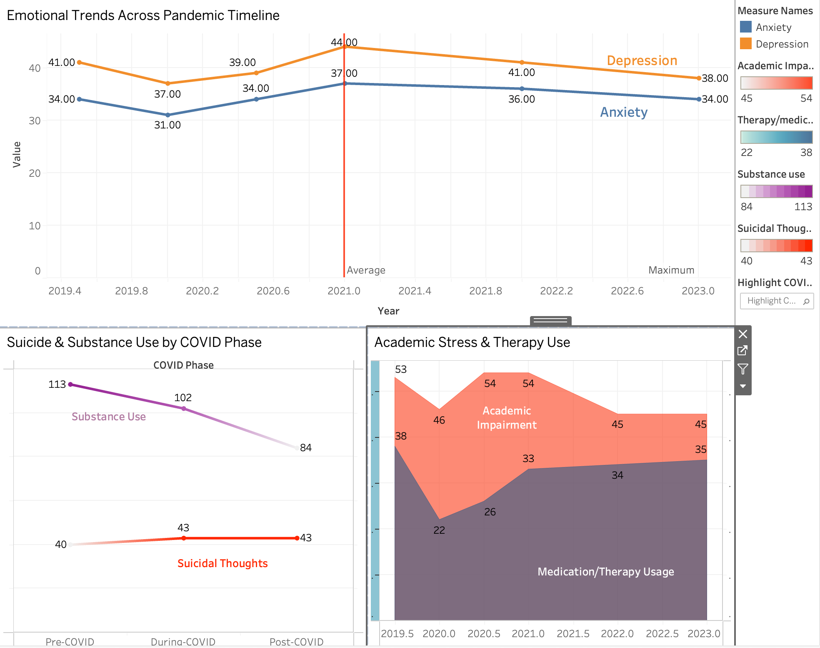


Slide 5
Outcome:
The data supports the hypothesis. These trends indicate lasting emotional and academic impacts on U.S. college students. Even after the peak of the pandemic, rates of depression, anxiety, and suicidal ideation remain elevated, reflecting ongoing psychological strain. The steady increase in therapy and medication use points to a growing dependence on mental health services, while consistently high academic impairment highlights continued struggles with concentration, motivation, and performance. Although substance use declined—possibly due to limited access or changing coping strategies—the persistence of suicidal thoughts underscores the severity of distress. Collectively, these patterns emphasize the urgent need for colleges to establish long-term, accessible mental health and academic support systems.

Slide 6
Hypothesis 2
In Texas public schools, the increase in COVID-19 cases during the 2020–2021 academic year is associated with a statistically significant decrease in student attendance rates by 1.21%, compared to previous years.

Slide 7
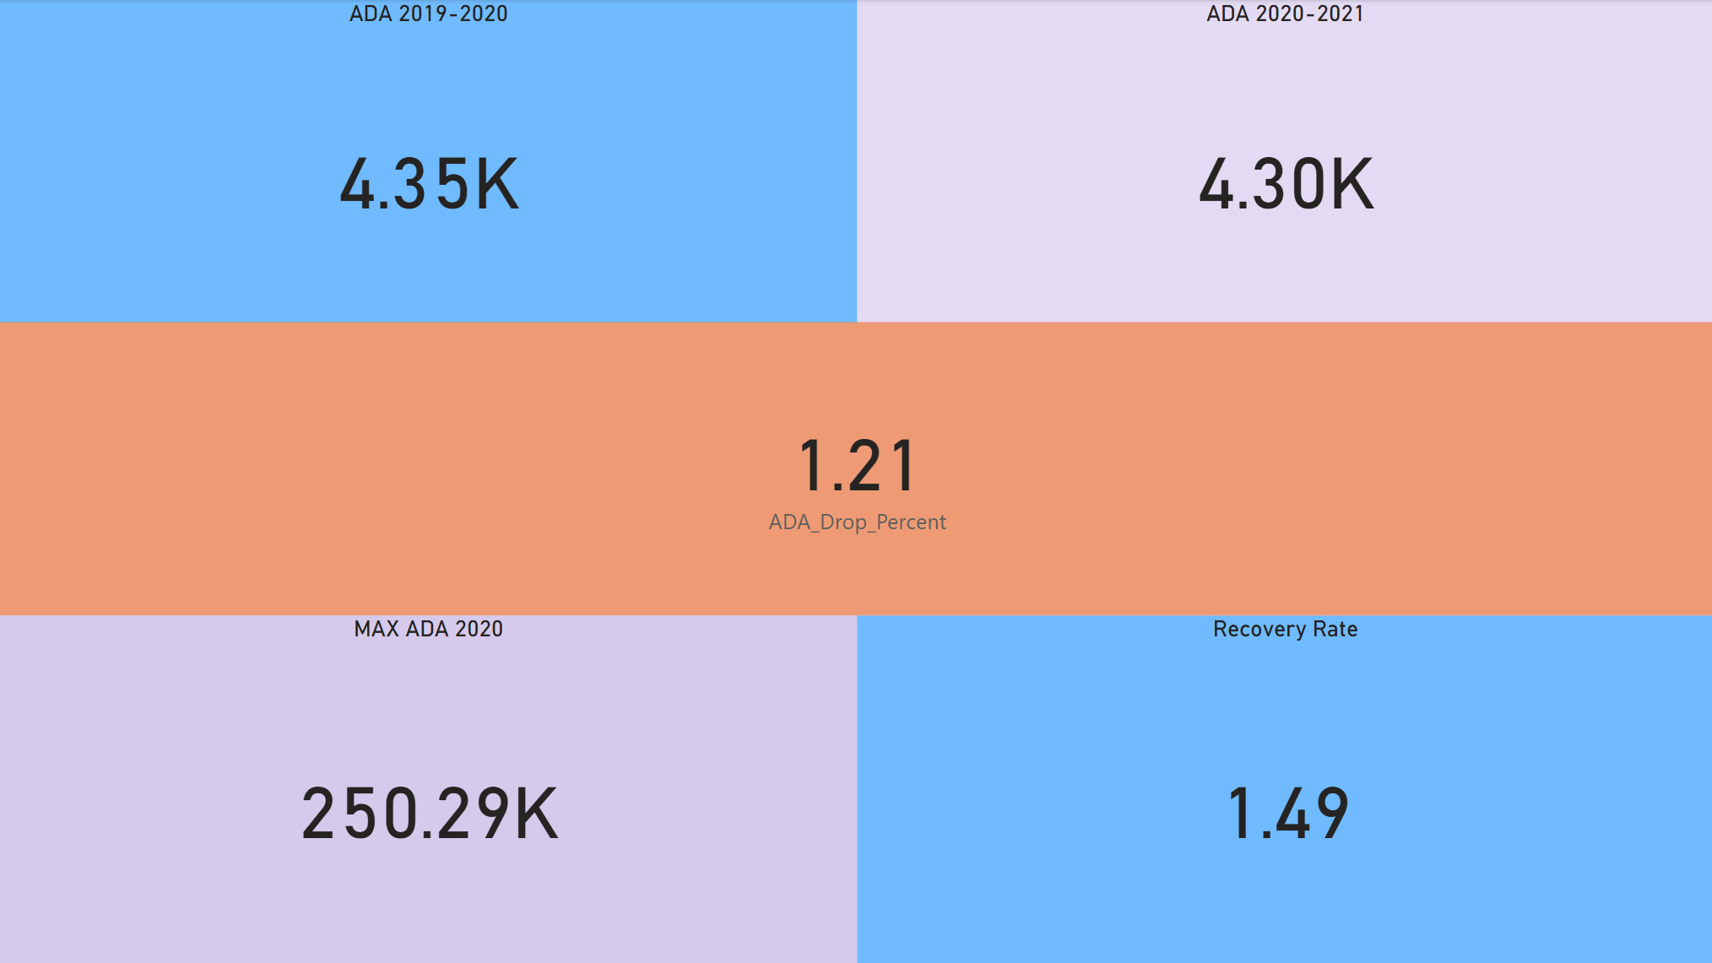

Slide 8
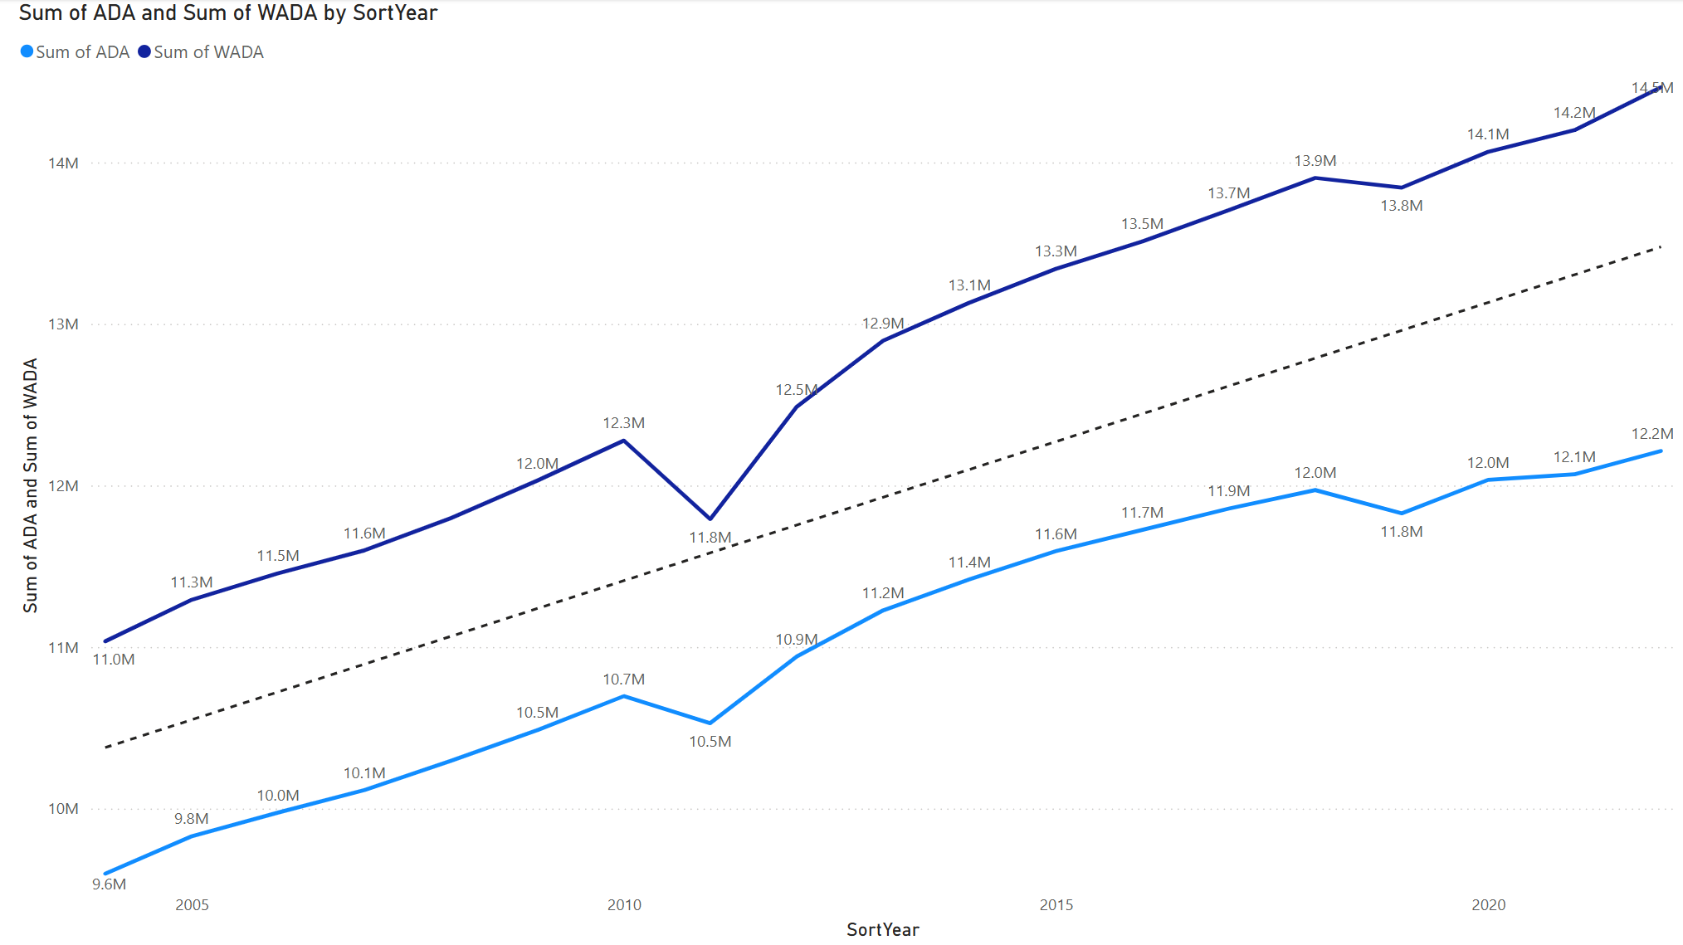

Slide 9
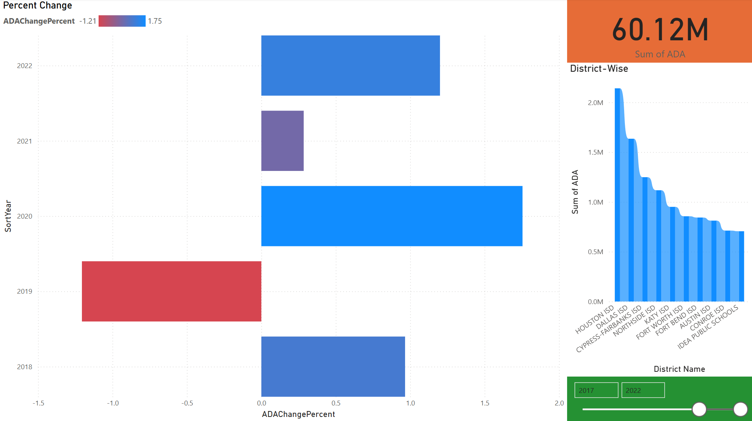

Slide 10
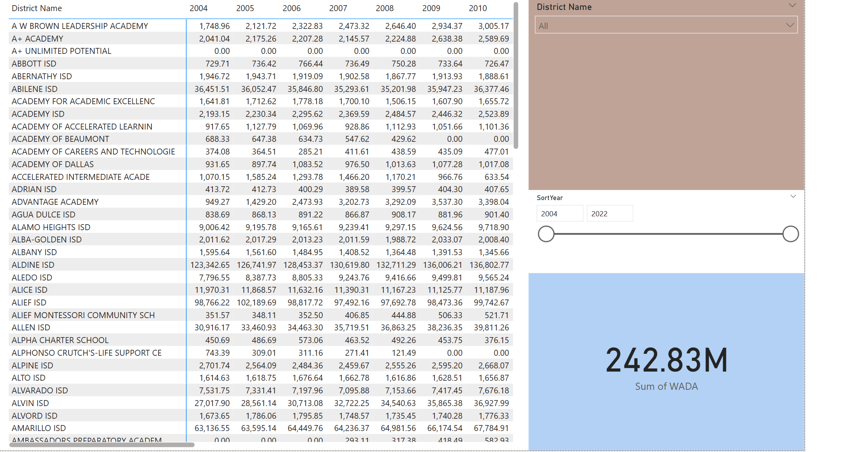

Slide 11
Outcome
Through our analysis, we were able to validate the hypothesis that student attendance rates in Texas public schools declined during the 2020–2021 academic year as a result of the COVID-19 pandemic. Our visualizations clearly revealed a 1.2% drop in Average Daily Attendance (ADA) compared to the previous academic year. This decline was consistently observed across multiple districts, suggesting that the impact was widespread rather than isolated.

Slide 12

Hypothesis 3
The transition to remote learning during the COVID-19 pandemic caused a decline of over 60% in the percentage of Hispanic students meeting grade-level standards in Dallas County between 2019 and 2023. Despite the return to in-person learning, recovery has been uneven, with Hispanic and Pacific Islander students showing slower academic recovery compared to other groups, widening existing educational disparities.

Slide 13
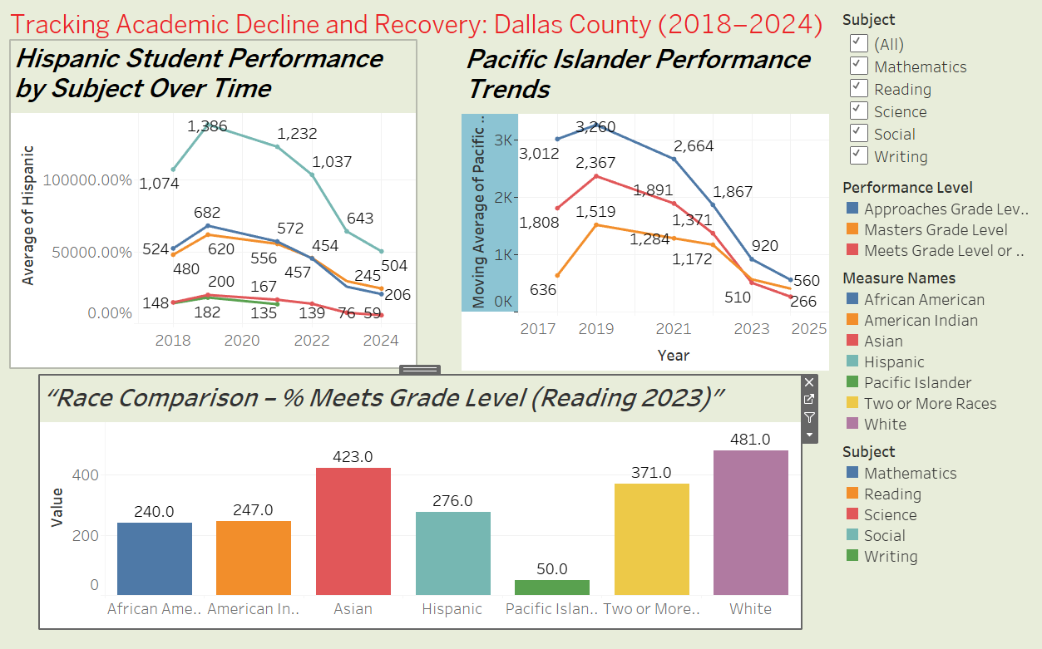

Slide 14
Outcome:
The data strongly supports the hypothesis that student performance declined significantly after COVID, particularly due to remote learning. Minority groups — especially Hispanic and Pacific Islander students — experienced the steepest declines, and even after schools reopened, academic recovery has been slow and unequal, exposing long-standing educational disparities.

Slide 15
Hypothesis 4:​
In Texas counties, high school students (Grades 9–12) observed an approximate 25% increase in retention rates between the 2018–19 and 2020–21 school years, compared to elementary and middle school students. This notable rise suggests that older students may have been more affected by academic disruptions such as difficulties adapting to remote learning environments and reduced teacher interaction during the COVID-19 pandemic.

Slide 16
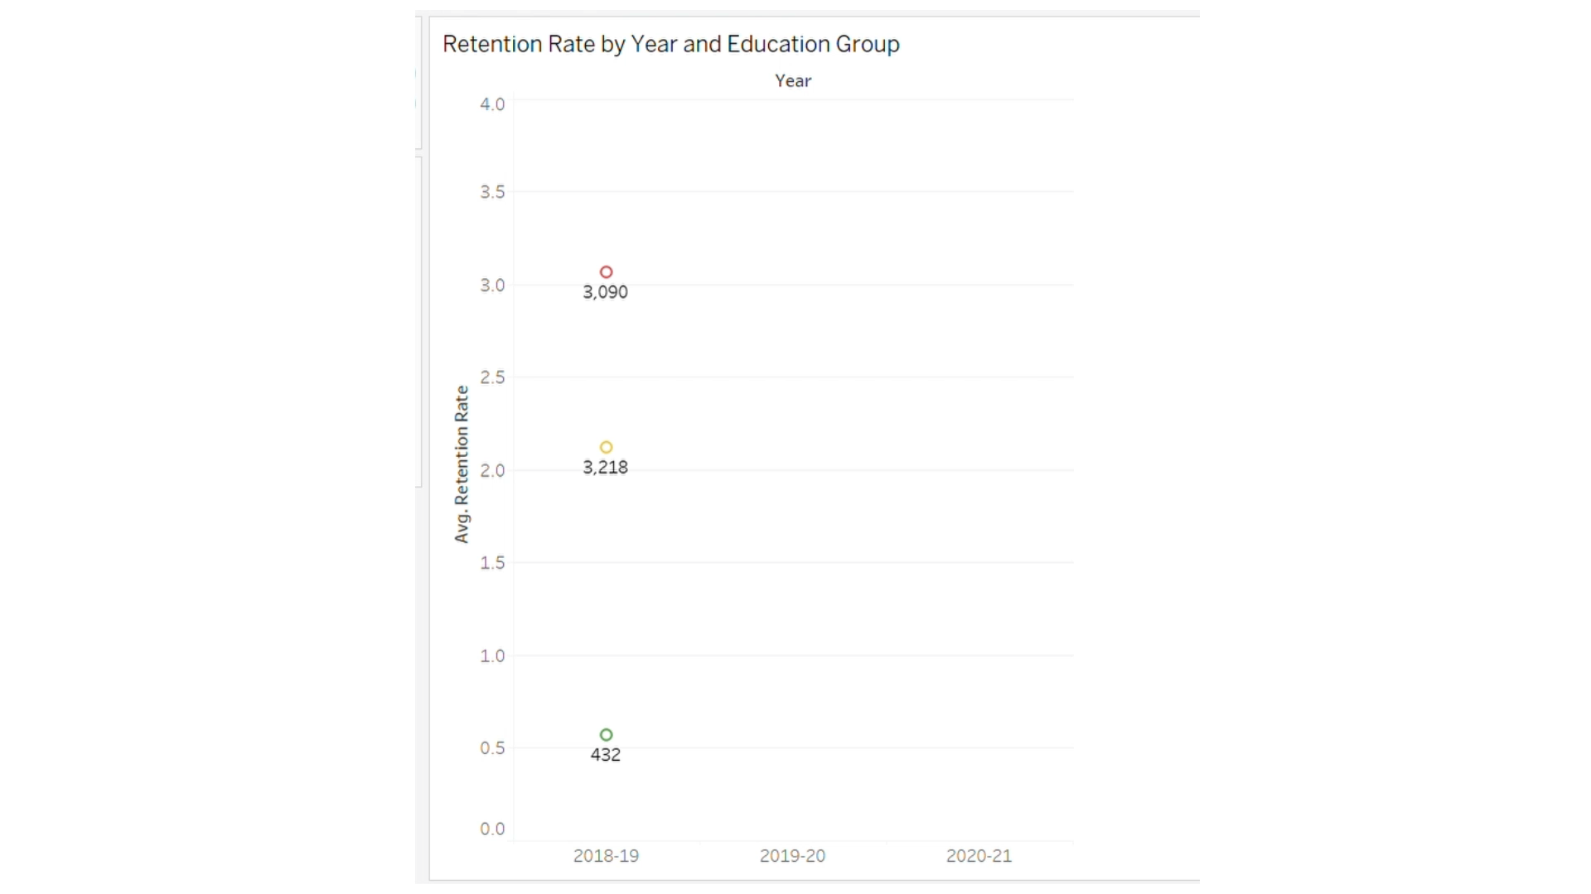

Slide 17
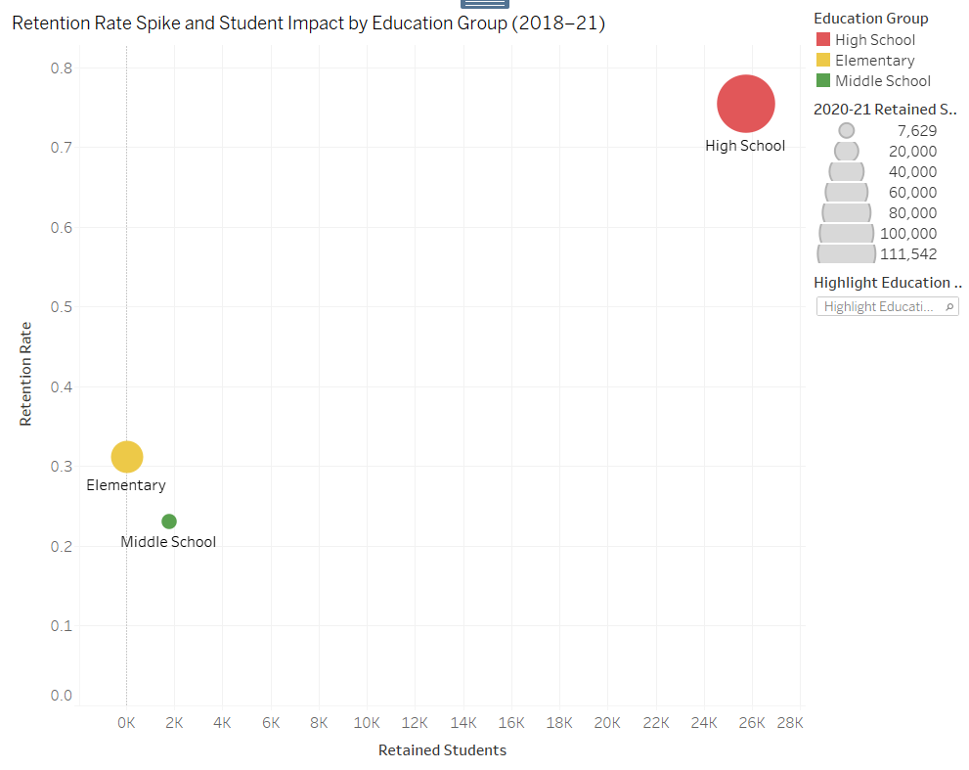

Slide 18
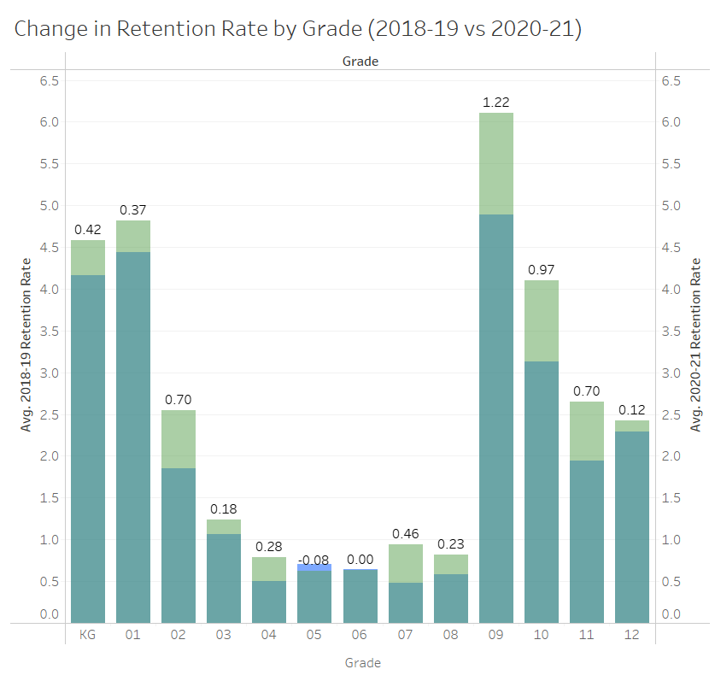
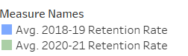

Slide 19
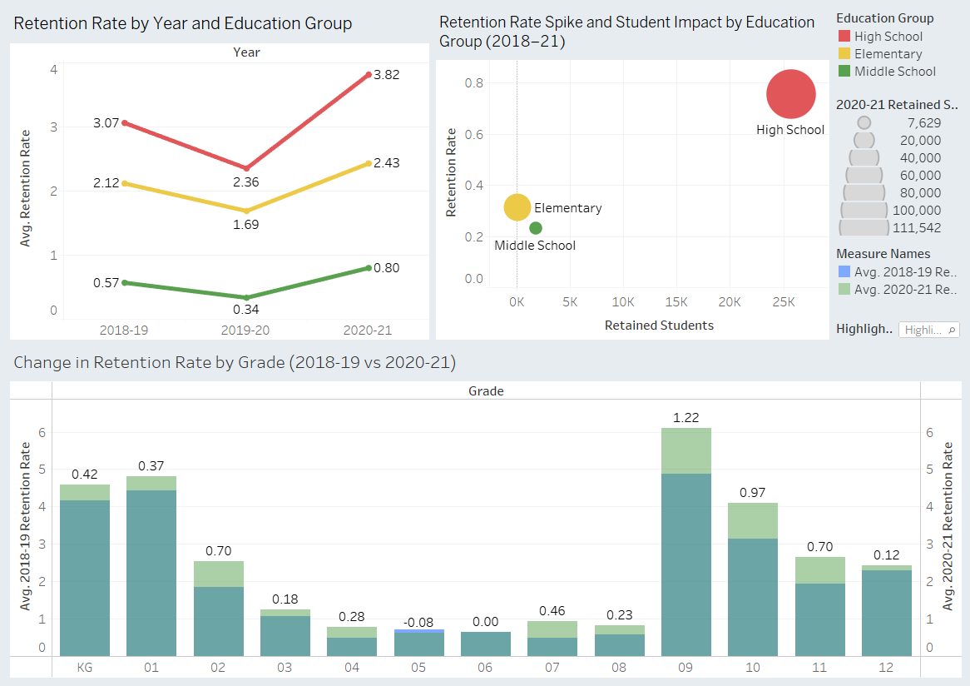

Slide 20
Outcome:
The data confirms that grade level retention rate increased across all education groups in Texas between the year 2018-19 and 2020-21, but there was a significant increase (about 25%) in the High school grades compared to other grades. This trend suggests a deeper impact on academic progression for older students.

Slide 21
Hypothesis 5:
In Texas counties, a 5% increase in poverty between 2018–19 and 2020–21 will lead to an approximate 2% increase in high school dropout rates, suggesting that rising economic disadvantage may be a driving factor in educational disengagement potentially due to disparities in access to internet, technology, and consistent adult support during the pandemic
*Poverty Rate is defined as the rate of students who are eligible for free and reduced lunch as per NCES (National Council)

Slide 22
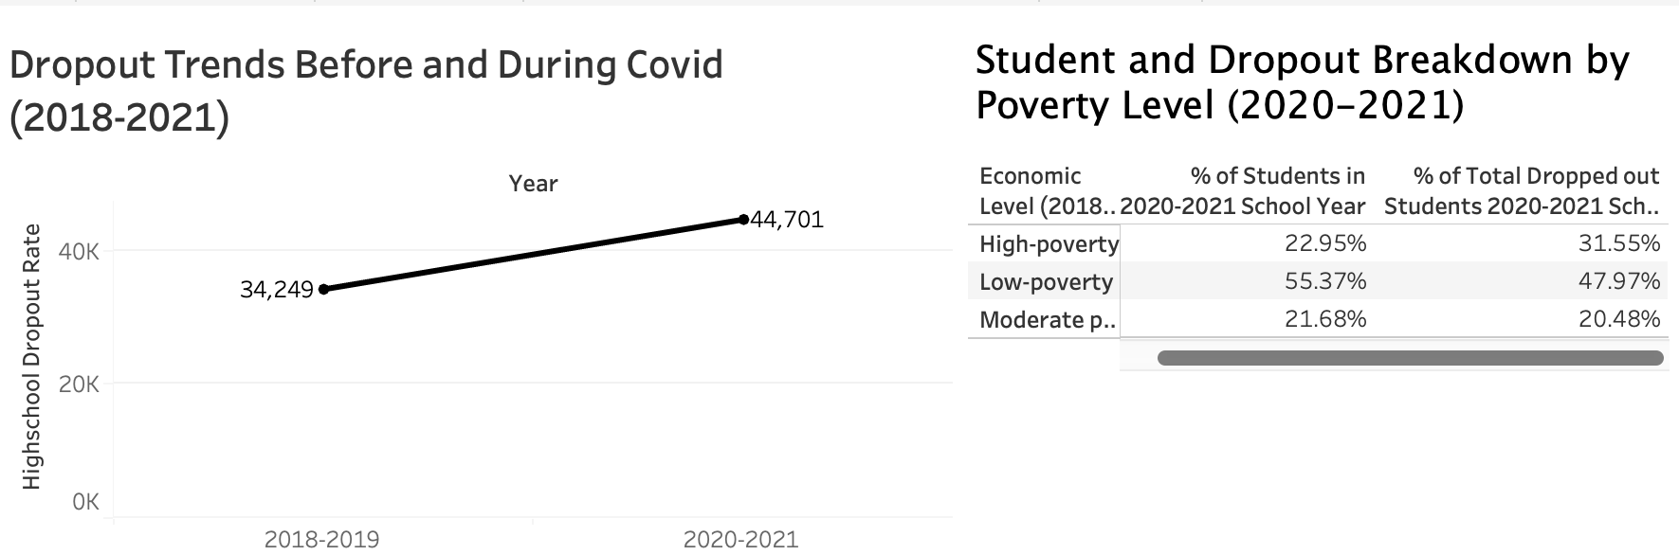

Slide 23
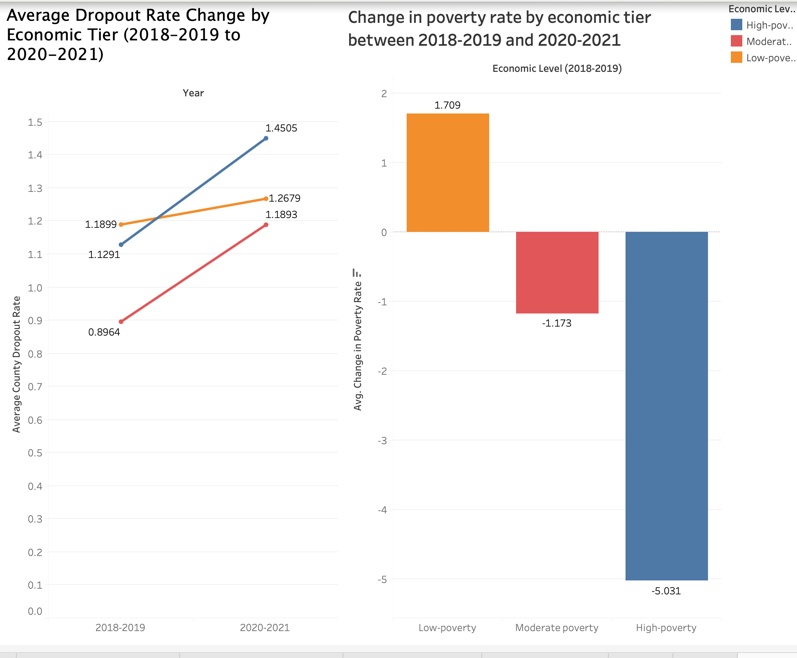

Slide 24
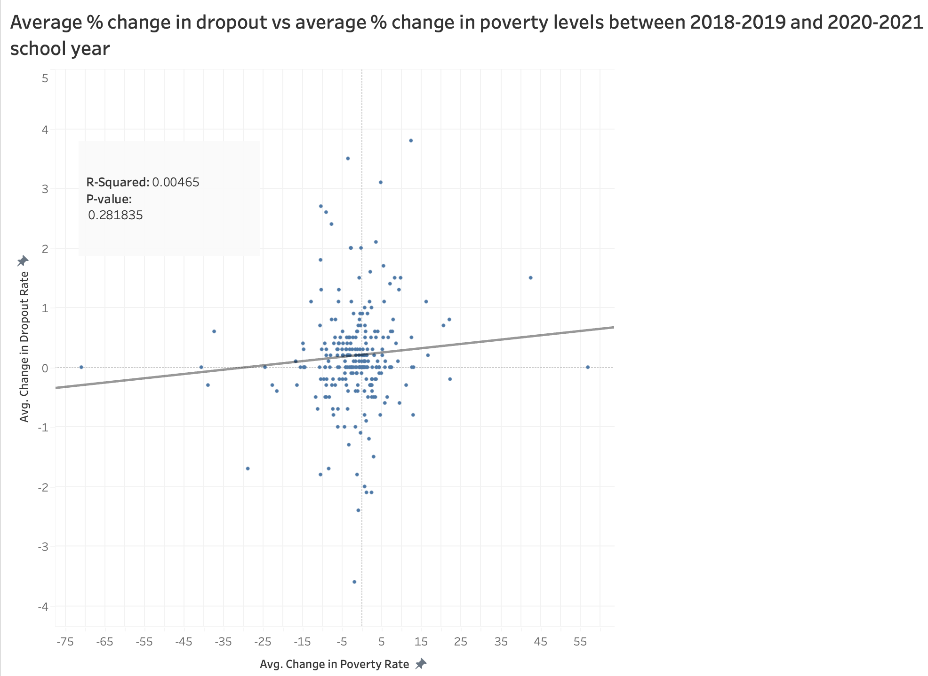

Slide 25
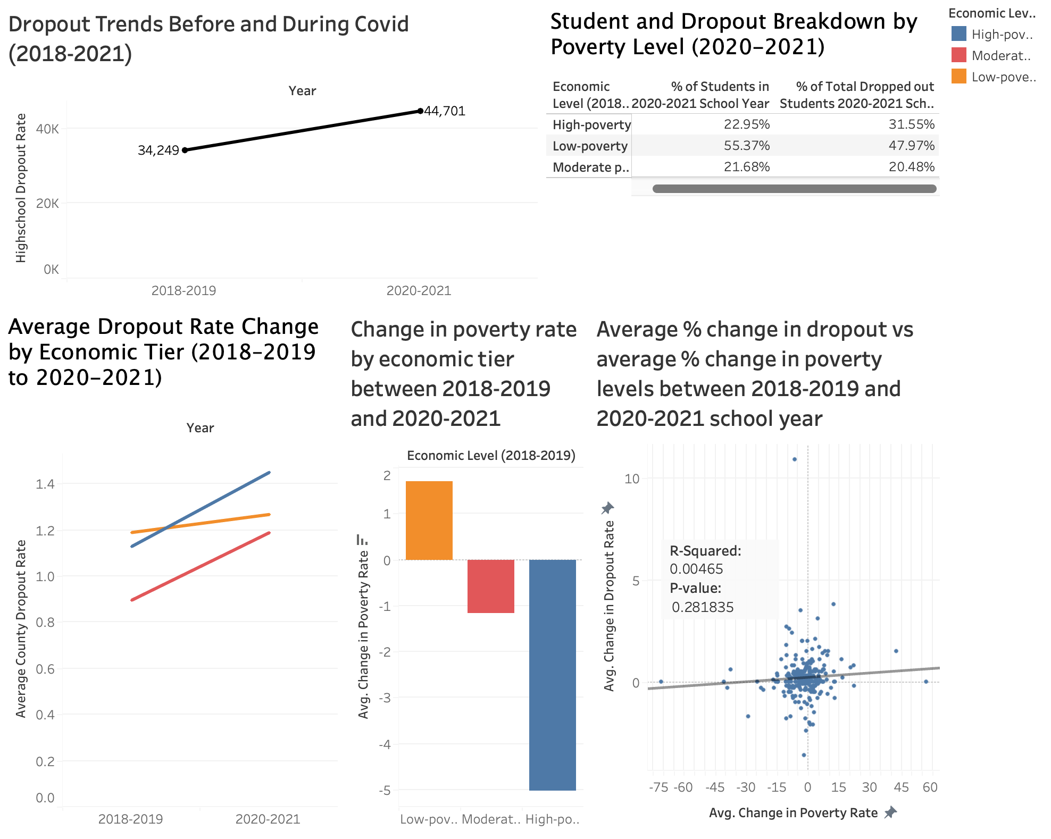

Slide 26
Outcome:
Although areas with historical higher poverty levels tended to have higher dropout rates, there does not appear to be a meaningful relationship between increases in poverty and increases in dropout rates. This may be due to misclassification or data inconsistencies during the COVID-19 pandemic, which made tracking poverty more difficult.

Slide 27

Thank You

